Slide 1
Bits and Binary Systems
Computer Programming – Fall 2017
Department of Computer Science & Eng. AUMC
Instructor: Ahmad Mohsin

Slide 2
Bits and binary
Computers use binary - the digits 0 and 1 - to store data. A binary digit, or bit, is the smallest unit of data in computing. It is represented by a 0 or a 1. Binary numbers are made up of binary digits (bits), eg the binary number 1001.
.

Slide 3
Transistors
The circuits in a computer's processor are made up of billions of transistors. A transistor is a tiny switch that is activated by the electronic signals it receives. The digits 1 and 0 used in binary reflect the on and off states of a transistor

Slide 4
Machine Code
Computer programs are sets of instructions. Each instruction is translated into machine code - simple binary codes that activate the CPU. Programmers write computer code and this is converted by a translator into binary instructions that the processor can execute.
All software, music, documents, and any other information that is processed by a computer, is also stored using binary.

Slide 6
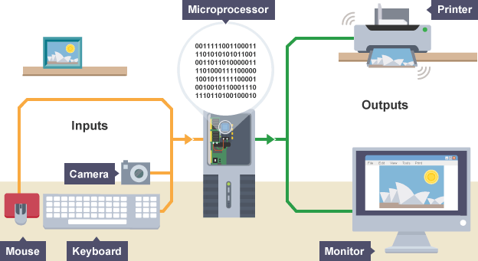
Encoding process

Slide 7
Contd..
Everything on a computer is represented as streams of binary numbers. Audio, images and characters all look like binary numbers in machine code. These numbers are encoded in different data formats to give them meaning, eg the 8-bit pattern 01000001 could be the number 65, the character 'A', or a colour in an image.

Slide 8
Encoding formats have been standardised to help compatibility across different platforms.
For example:
audio is encoded as audio file formats, eg mp3, WAV, AAC
video is encoded as video file formats, eg MPEG4, H264
text is encoded in character sets, eg ASCII, Unicode
images are encoded as file formats, eg BMP, JPEG, PNG
The more bits used in a pattern, the more combinations of values become available. This larger number of combinations can be used to represent many more things, eg a greater number of different symbols, or more colours in a picture.

Slide 9
Operations consist of a set of instructions and data. Operations are made up of opcodes and operands. The opcode performs an action on an operand.

Slide 10
Bits and bytes
Bits can be grouped together to make them easier to work with. A group of 8 bits is called a byte.
Other groupings include:
Nibble - 4 bits (half a byte)
Byte - 8 bits
Kilobyte (KB) - 1000 bytes
Megabyte (MB) - 1000 kilobytes
Gigabyte (GB) - 1000 megabytes
Terabyte (TB) - 1000 gigabytes

Slide 11
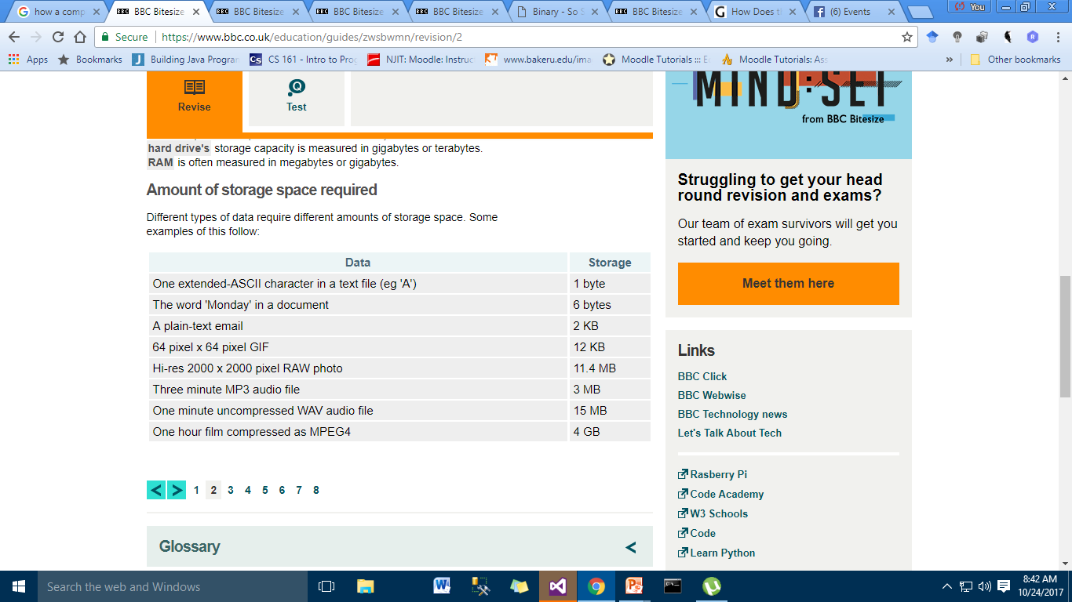

Slide 12
Binary and denary
The binary system on computers uses combinations of 0s and 1s.
In everyday life, we use numbers based on combinations of the digits between 0 and 9. This counting system is known as decimal, denary or base 10.
A number base indicates how many digits are available within a numerical system. Denary is known as base 10 because there are ten choices of digits between 0 and 9. For binary numbers there are only two possible digits available: 0 or 1. The binary system is also known as base 2.
All denary numbers have a binary equivalent and it is possible to convert between denary and binary.

Slide 13
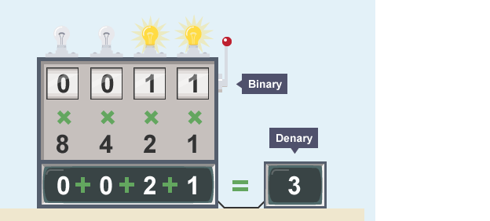

Slide 14
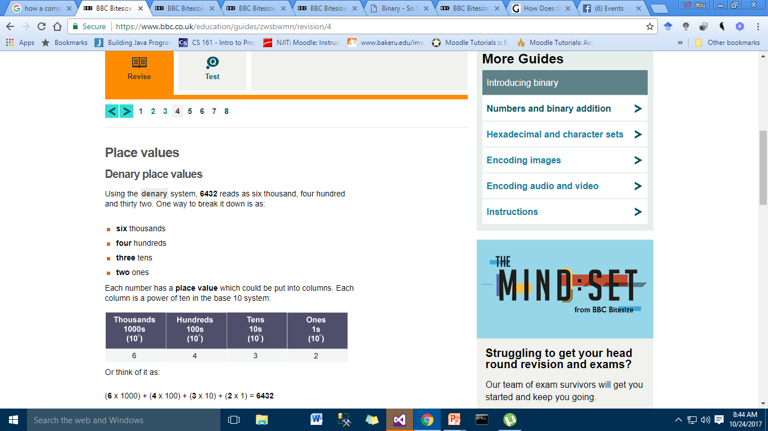

Slide 15
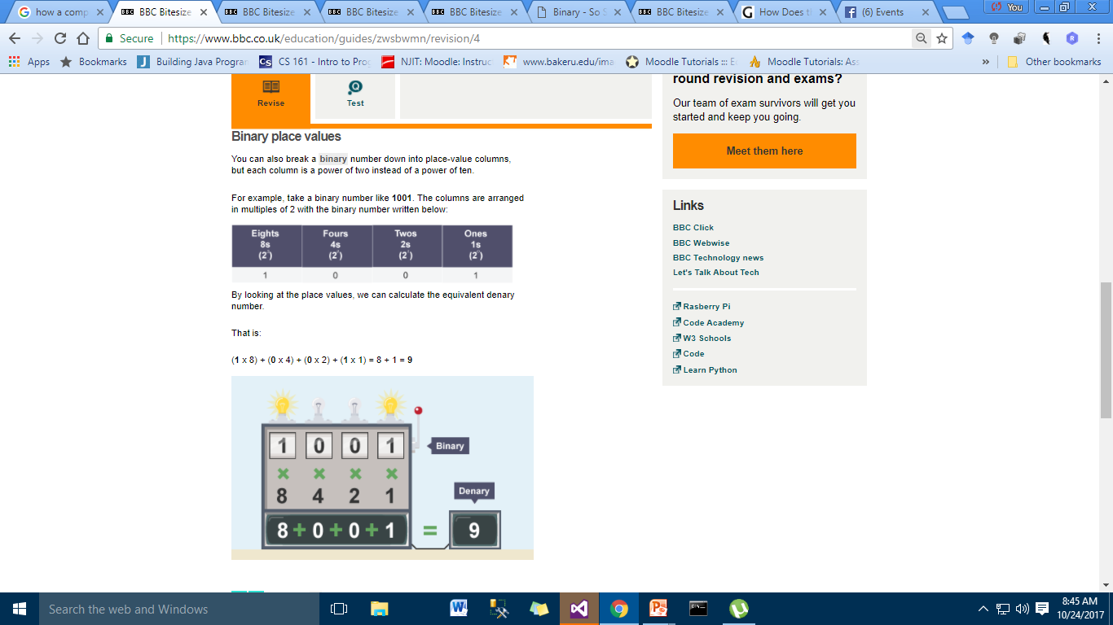

Slide 16
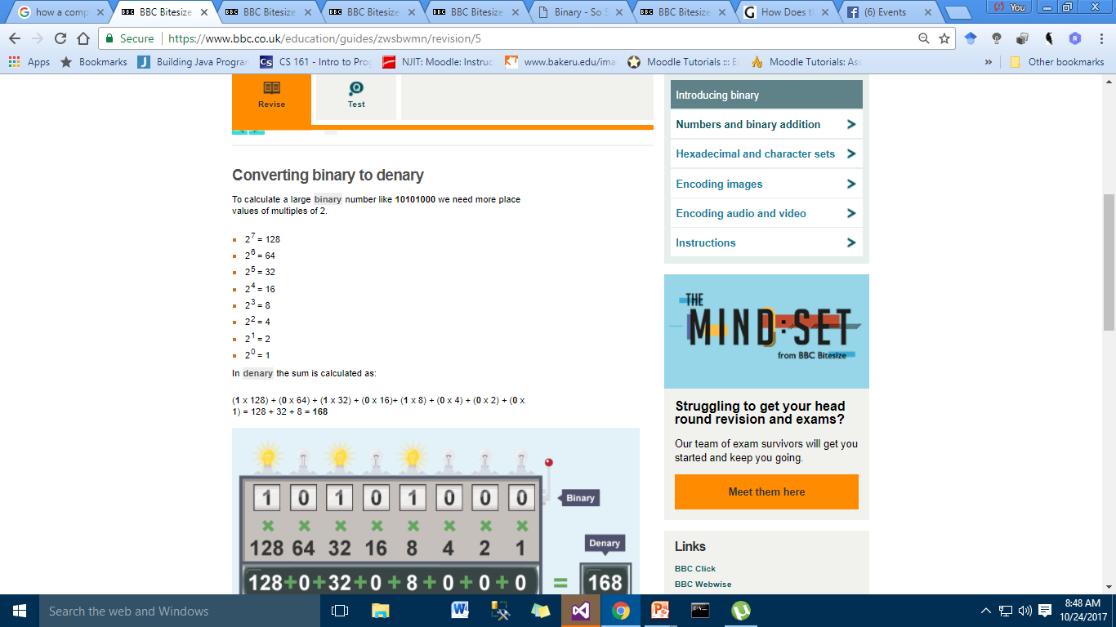

Slide 17
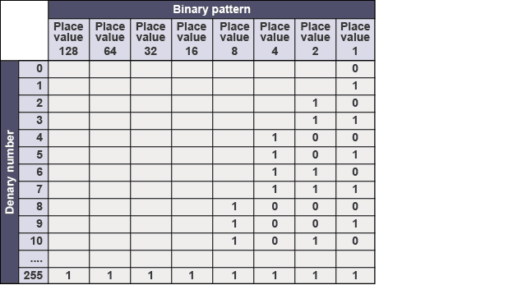

Slide 18
